Slide 1
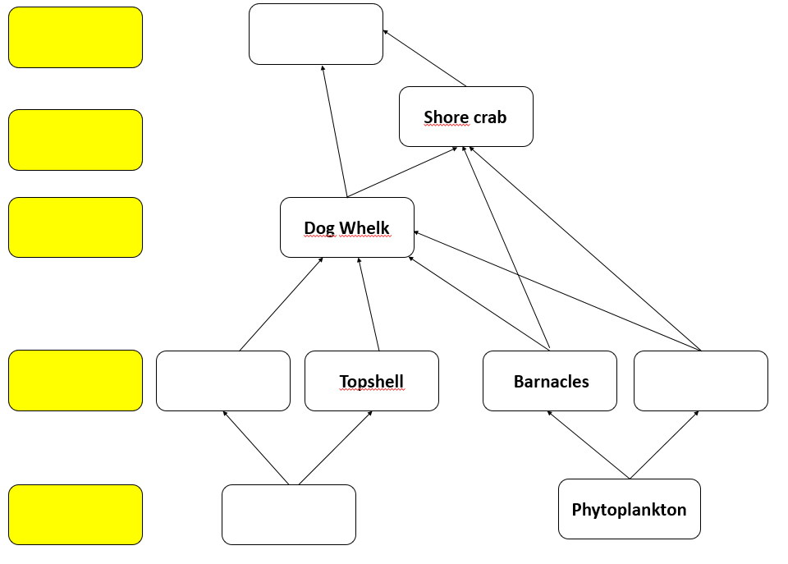

ECOSYSTEMS, NUTRIENT CYCLES AND HUMAN IMPACT ON THE ENVIRONMENT - WJEC Unit 1.6
Food webs
Use your knowledge from the fieldtrip to complete the food web below:
Label producers, first, second and third level consumers.
Complete the food web with the organisms in orange on the right.
Connect one of the first level consumers to the top predator.
Circle one carnivore on the food web.
Fourth level consumer
Seagull
Gwymon codog mân
Gwichiaid cyffredin
Third level consumer
Seagull
Second level consumer
Mussels
First level consumer
Common Periwinkle
Mussels
Producer
Bladder Wrack
What chemical reaction can all producers do?
Photosynthesis.
What do the arrows in a food web represent?
They represent the transfer of energy between trophic levels in a food chain/web.

Slide 2
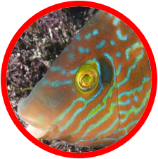
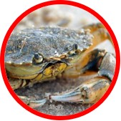
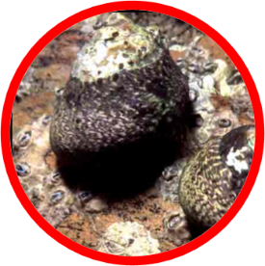
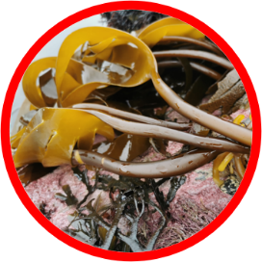
ECOSYSTEMS, NUTRIENT CYCLES AND HUMAN IMPACT ON THE ENVIRONMENT - WJEC Unit 1.6
2. Pyramids of numbers
Complete the pyramid of numbers below to show 40 Topshells as first level consumers.
2 Corkwing Wrasse
8 Shore Crabs
12cm
2 Kelp plants
Why is this not a good way of showing the energy at different trophic levels in the food chain?
2 kelp plant contain a lot more energy than the trophic levels above.
What would be a better way of representing this, that would create a true pyramid shape?
A better way of presenting this would be using a pyramid of biomass.
Why do the number of organisms get smaller as you move further up through a food chain?
Energy has been transferred out of the food chain e.g. as heat from respiration at each trophic level.
Name two processes that use energy in an organism?
Growth of new cells
Repair of old cells
Which other ways are energy lost at each level in a food chain?
As waste in the form of heat from respiration, Faeces and urine.

Slide 3
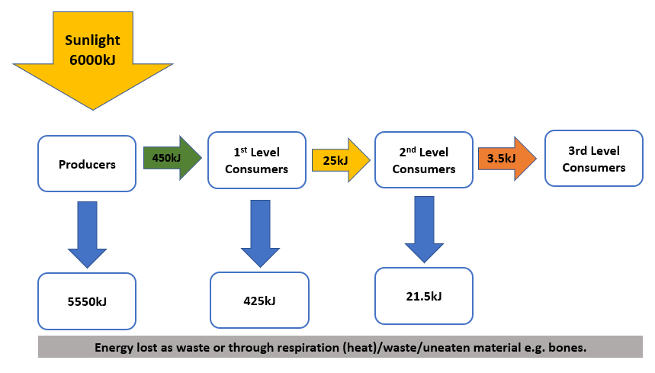
ECOSYSTEMS, NUTRIENT CYCLES AND HUMAN IMPACT ON THE ENVIRONMENT - WJEC Unit 1.6
Energy efficiency in food chains.
÷
x
6000kJ 450kJ 100 = 7.5%
Calculate the efficiency of producers at transferring energy from the sun:
Now calculate the efficiency of the second level consumers:
÷
x
3.5 kJ 25 kJ 100 = 14%

