Slide 1
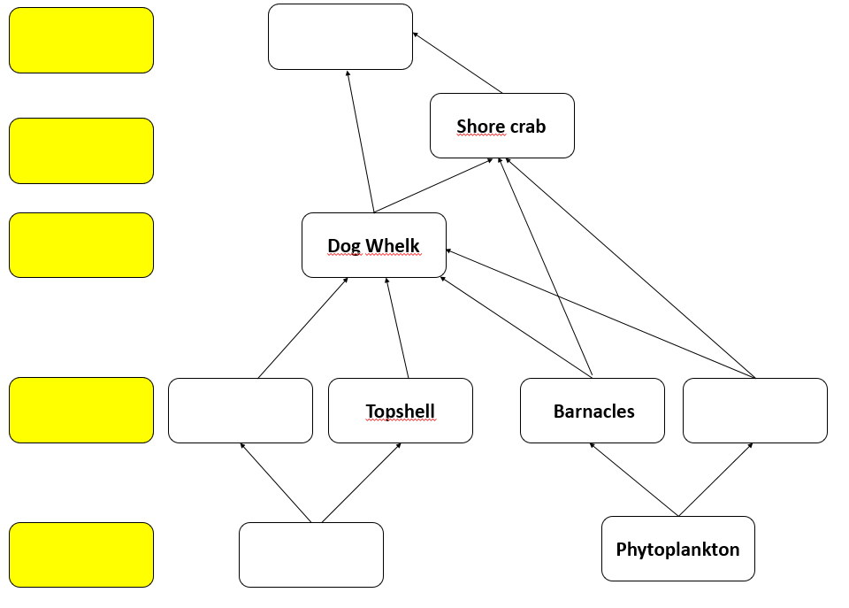

ECOSYSTEMS, NUTRIENT CYCLES AND HUMAN IMPACT ON THE ENVIRONMENT - WJEC Unit 1.6
Food webs
Use your knowledge from the fieldtrip to complete the food web below:
Label producers, first, second and third level consumers.
Complete the food web with the organisms in orange on the right.
Connect one of the first level consumers to the top predator.
Circle one carnivore on the food web.
Bladder Wrack
Dog Whelk
Seagull
Mussels
Second level consumer
Producer
Third level consumer
First level consumers
Fourth level consumer
What do all producers have in common?
What do the arrows in a food web represent?

Slide 2
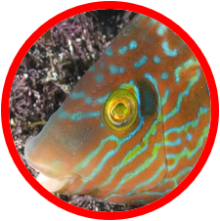
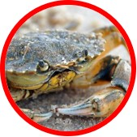
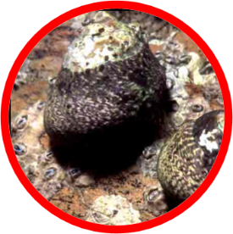
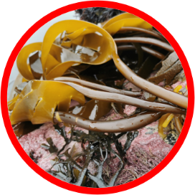
ECOSYSTEMS, NUTRIENT CYCLES AND HUMAN IMPACT ON THE ENVIRONMENT - WJEC Unit 1.6
2. Pyramids of numbers
Complete the pyramid of numbers below to show 40 Topshells as first level consumers.
2 Corkwing Wrasse
8 Shore Crabs
2 Kelp plants
Why is this not a good way of showing the energy at different trophic levels in the food chain?
What would be a better way of representing this, that would create a true pyramid shape?
Why do the number of organisms get smaller as you move further up through a food chain?
Organisms use energy for growth of new cells, which other way do they use energy?
Which other ways is energy lost at each level in a food chain?

Slide 3
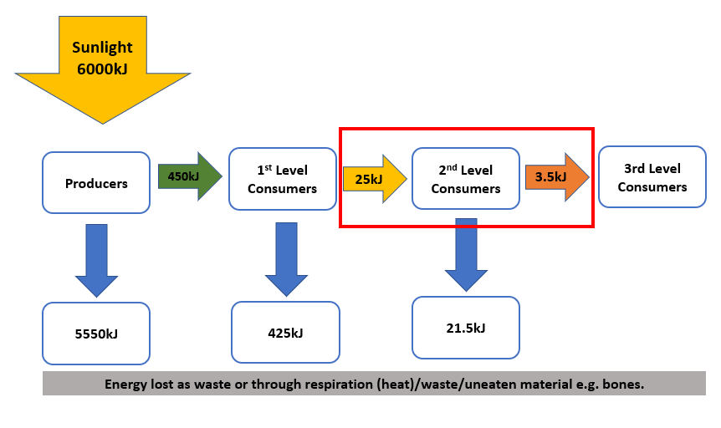
ECOSYSTEMS, NUTRIENT CYCLES AND HUMAN IMPACT ON THE ENVIRONMENT - WJEC Unit 1.6
Energy efficiency in food chains.
Calculate the efficiency of 2nd level consumers in the food chain above:
Follow this format that we used to calculate the efficiency of first level consumers in our example:
25kJ ÷ 450kJ x 100 = 5.6% efficiency
Now try working out how efficient producers are at trapping energy from the sun. Use the space below to show your working:
÷
x
=
% efficiency

