Slide 1
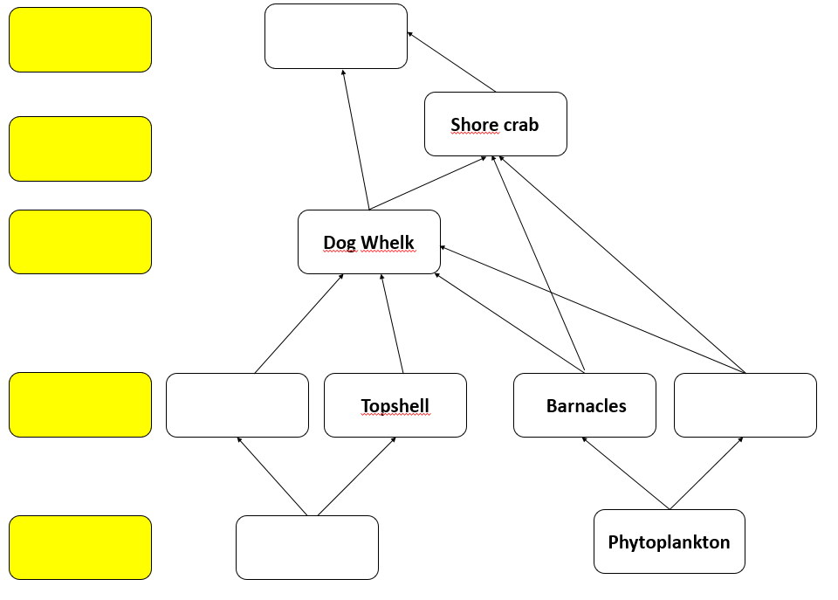

ECOSYSTEMS, NUTRIENT CYCLES AND HUMAN IMPACT ON THE ENVIRONMENT - WJEC Unit 1.6
Food webs
Use your knowledge from the fieldtrip to complete the food web below:
Label producers, first, second and third level consumers.
Complete the food web with the organisms in orange on the right.
Connect one of the first level consumers to the top predator.
Circle one carnivore on the food web.
Bladder Wrack
Common Periwinkle
Sea gull
Producer
Third level consumers
Fourth level consumer
Second Level Consumer
First level consumers
Mussels
From where do all producers get their energy?
What do the arrows in a food web represent (underline the correct answer below)?
Which organism is eating another.
The energy flow through the food web.
The direction an organism is moving in an ecosystem.

Slide 2
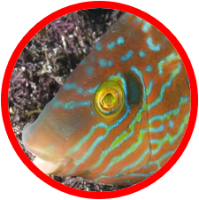
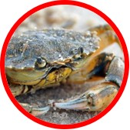
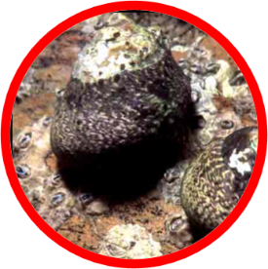
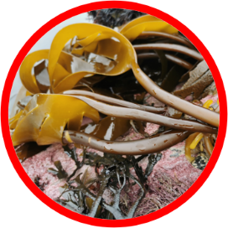
ECOSYSTEMS, NUTRIENT CYCLES AND HUMAN IMPACT ON THE ENVIRONMENT - WJEC Unit 1.6
2. Pyramids of numbers
Complete the pyramid of numbers below to show 40 Topshells as first level consumers.
2 Corkwing Wrasse
8 Shore Crabs
2 Kelp plants
Graddfa: 1 unigolyn = 0.3mm
Why is this not a good way of showing the energy at different trophic levels in the food chain? What kind of diagram would show us this better?
Why do the number of organisms get smaller as you move further up through a food chain?
Organisms use energy for growth of new cells, which other way do they use energy?
Which other ways is energy lost at each level in a food chain (underline two below)?
Lose energy as heat in respiration Sweat
Sound energy Urine and faeces

Slide 3
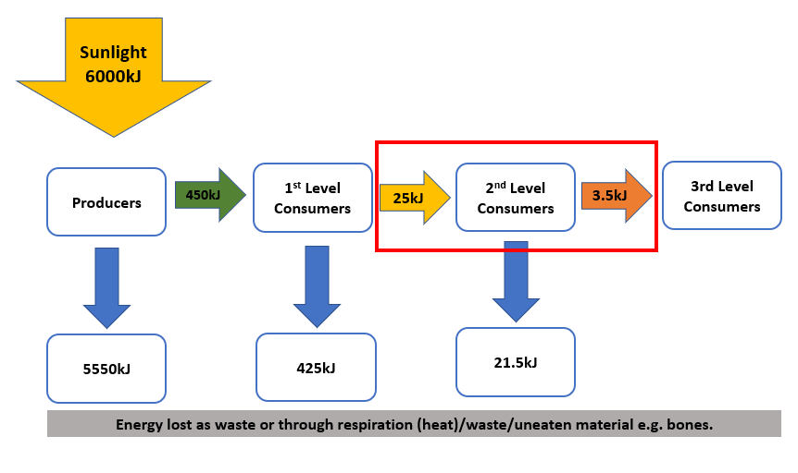
ECOSYSTEMS, NUTRIENT CYCLES AND HUMAN IMPACT ON THE ENVIRONMENT - WJEC Unit 1.6
Energy efficiency in food chains.
Calculate the efficiency of 2nd level consumers in the food chain above:
Follow this format that we used to calculate the efficiency of first level consumers in our example:
25kJ ÷ 450kJ x 100 = 5.6% efficiency
÷
x
=
% efficiency

